Slide 1


iFlahs LIS Introduction

Slide 2
LIS Introduction
1
iFlash LIS setting & Introduction
2
FAQ
3
4
Q&A

Slide 3
LIS Introduction
The Laboratory Information System (LIS) is an Information System of the Laboratory (Laboratory Laboratory). Through a network of Laboratory instruments and computers, the Laboratory Information System enables patient samples to be logged on, experimental data to be accessed, reports to be reviewed, printed and distributed, and statistical analysis of experimental data to be performed in an intelligent, automated and standardized manner.It is helpful to improve the overall management level of the laboratory, reduce the loopholes and improve the inspection quality.

Slide 4
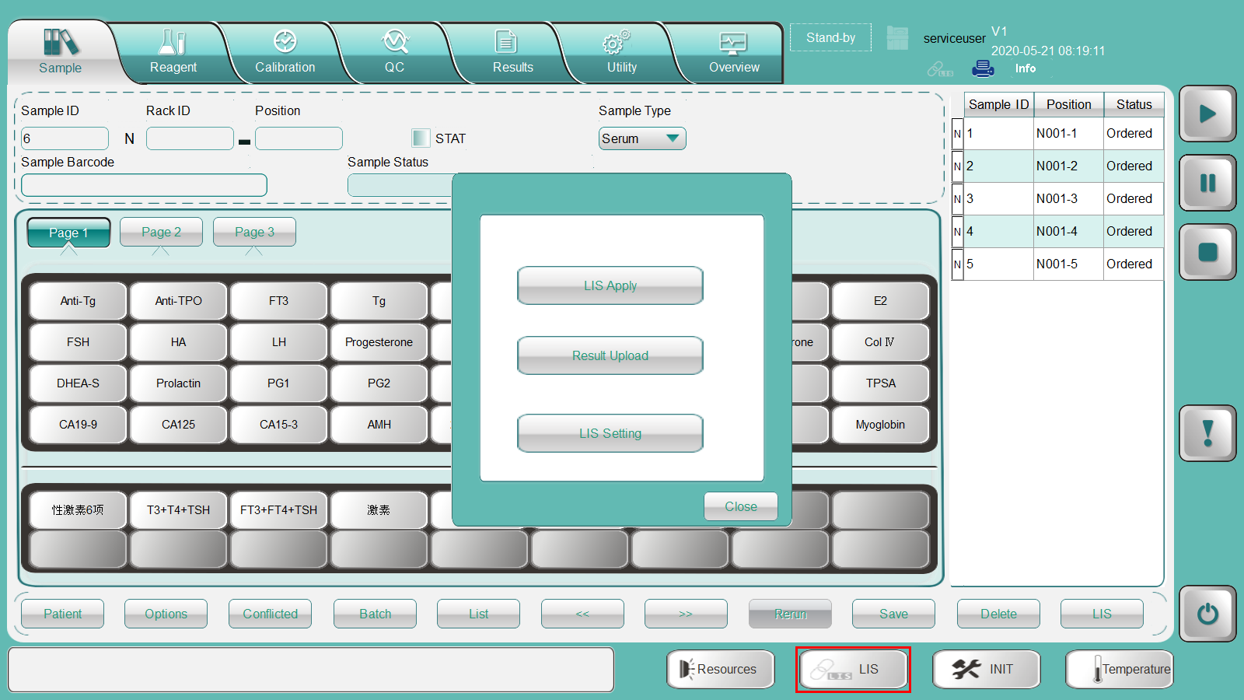
iFlash LIS

Slide 5
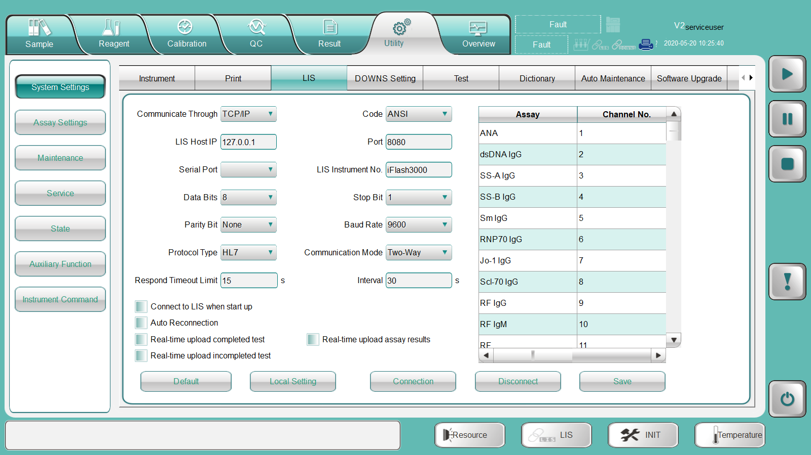
iFlash LIS setting

Slide 6
iFlash LIS setting
iFlash LIS Setting
Communication through | TCP/IP or Serial | Serial Port
Code | ANSI or UTF-8
LIS Host IP | Depends on customer site | /
Port | Depends on customer site | /
Serial Port | / | By LIS engineer
LIS Instrument No. | Availiable in iFlash 3000 software, normally no need to change it
Data Bits | / | Set by LIS engineer, default is 8
Stop Bit | / | Set by LIS engineer, default is 1
Parity Bit | / | Set by LIS engineer, default is "None"
Protocal Type | ASTM or HL7, depend on customer
Communication Mode | One-way(Unidirection) or Two-way(Bidirection)
Respond Timeout Limit | Default is "15s"
Interval | The time interval between automatic reconnection in the disconnected state .Default is "30s"
Connect to LIS when start up | Set by LIS engineer, normally checked.
Auto Reconnecntion | Set by LIS engineer, normally checked.
Real-time upload completed test | Set by LIS engineer, normally checked.
Real-time imupload completed test | Set by LIS engineer, normally checked.
Real-time imupload assay result | Set by LIS engineer, normally checked.
Assay & Channel No. | Same as assay ID, normally no need to change it.

Slide 7
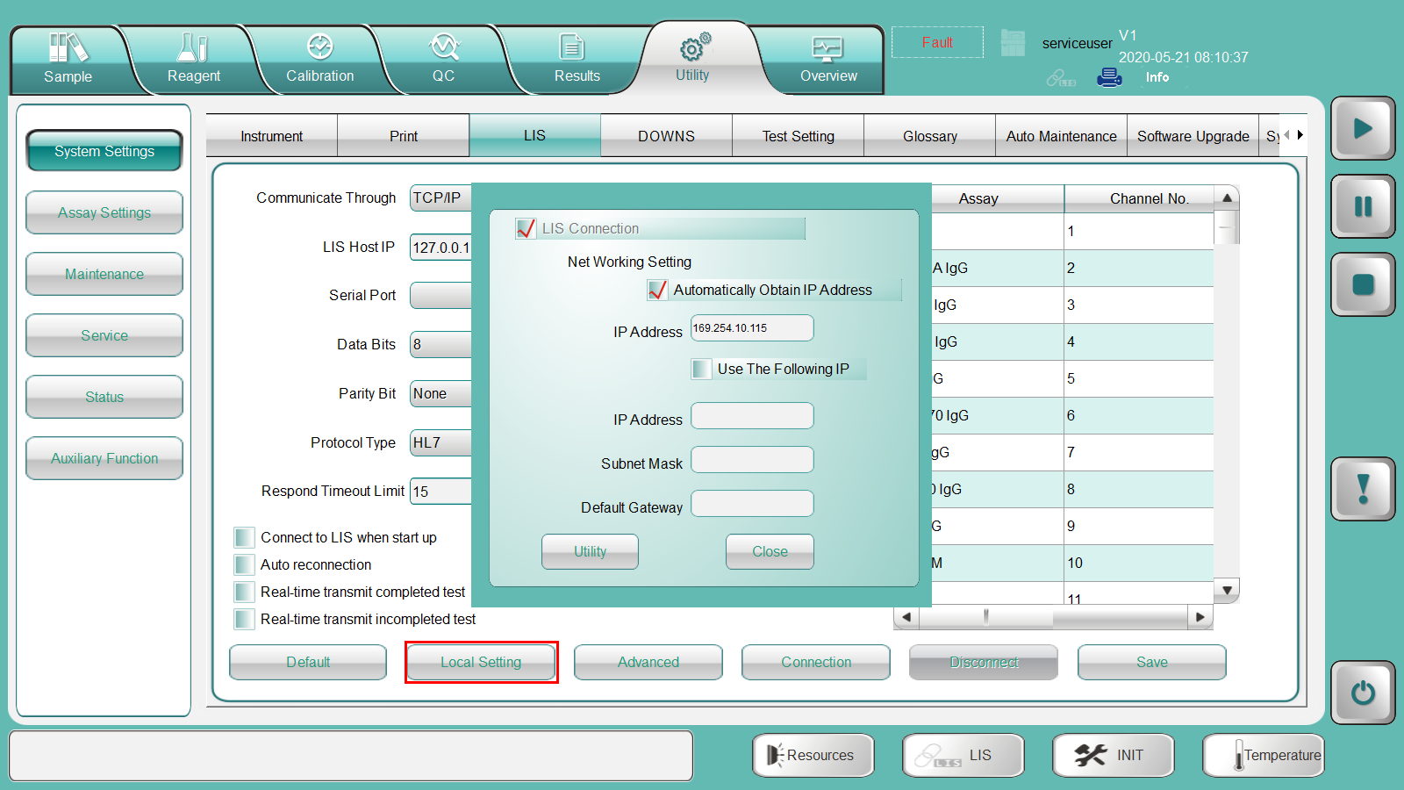
iFlash LIS setting

Slide 8
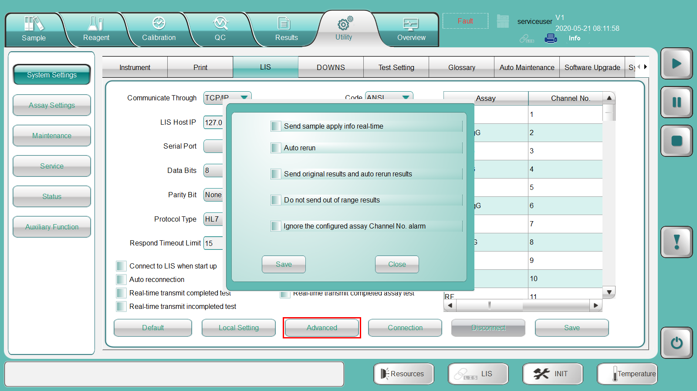
iFlash LIS setting

Slide 9
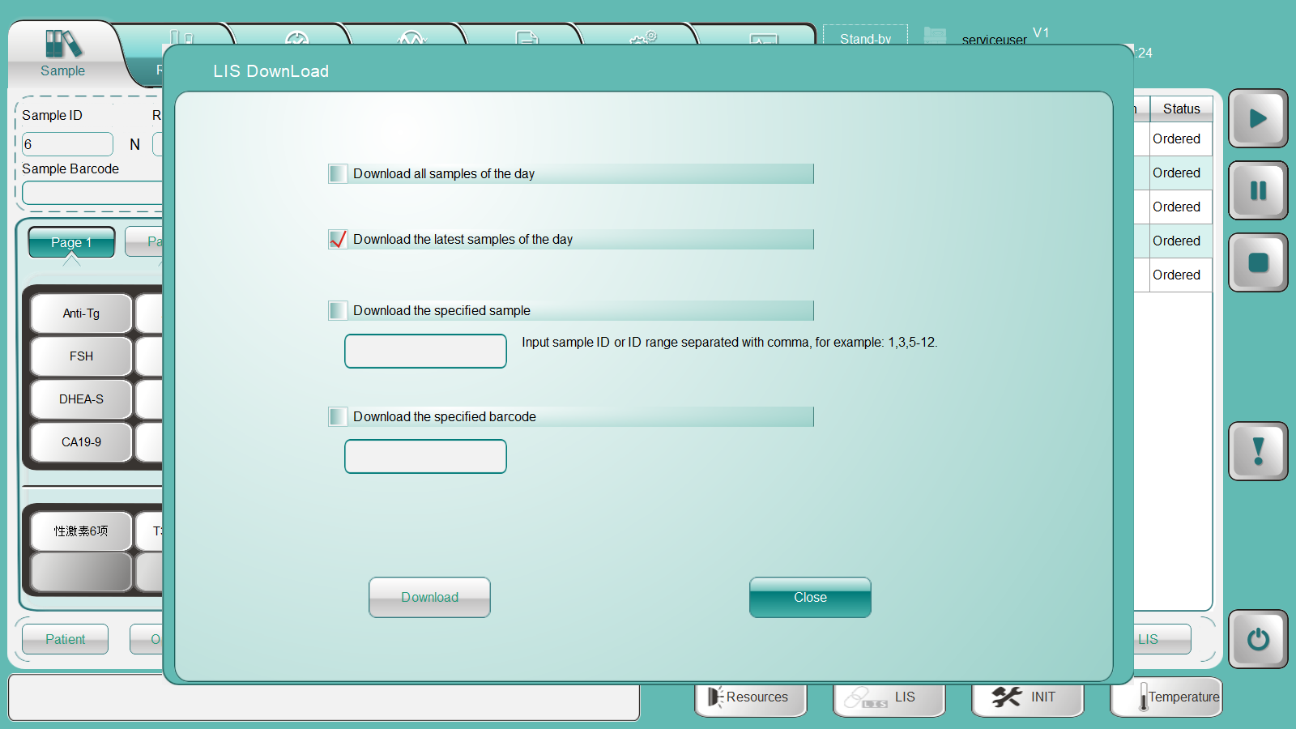
iFlash LIS apply
(download test insformation from LIS server manual)

Slide 10
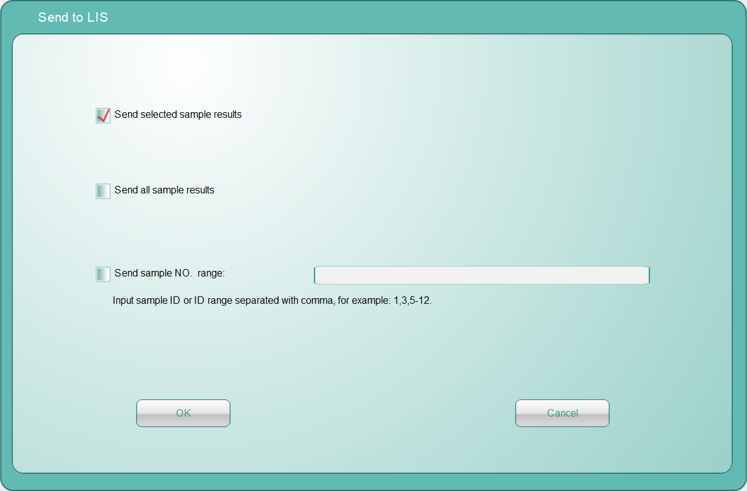
iFlash LIS - Result send to LIS

Slide 11
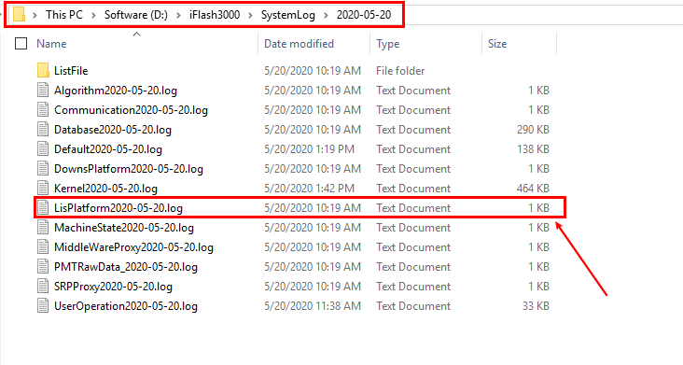
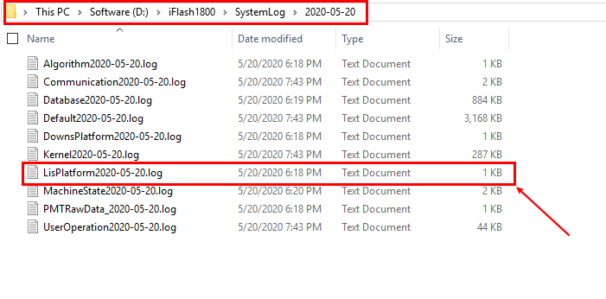
iFlash LIS log file

Slide 12
FAQ
1. Can't connect to the LIS server
Check the communication mode, TCP/IP or “Serial port”
For TCP/IP mode, please check IP address, port.---Try to ping the IP address we set.
For serial port, please check the serial port etc.

Slide 13
FAQ
2. Unable to download test information from LIS server
Serial port is not paired---Check the serial port
Channel No. is incorrect--- Check the channel No.
LIS server did not respond to inquiries in accordance with the protocol.
There is a conflict in the test information downloaded from the LIS server.
The LIS server has no corresponding test items---Check LIS server
Sample barocde is incorrect---Check the barcode

Slide 14
FAQ
3. The result uploaded to the LIS server is incorrect
LIS server mistakenly accepts the sample ID as the sample barcode or the sample barcode as the sample ID to receive the result---Ask LIS engineer to fix it.
The instrument and the LIS server are fake connections (LIS icon is blue but not connected )---manually disconnect and reconnect

Slide 15
FAQ
4. Does not automatically reconnect after disconnecting
Confirm communication through TCP / IP because the serial port does not support automatic reconnection.
Confirm whether the LIS server program has been exited or not opened.
Check if the connection is normal. (FAQ 1)

Slide 16
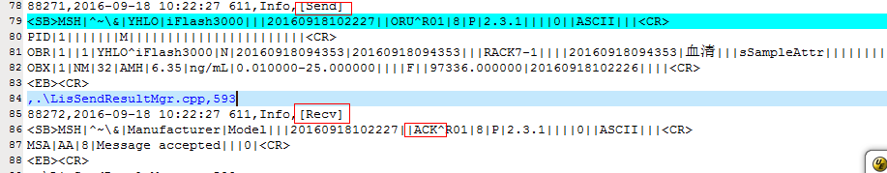
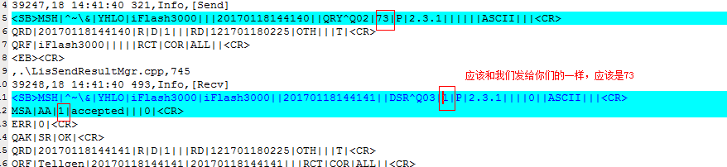
FAQ - Example
1. Error 0-4, communication timeout
a. The messagge reply from LIS server is incomplete, no DSR or ACK message
b. The message ID does not correspond

Slide 17
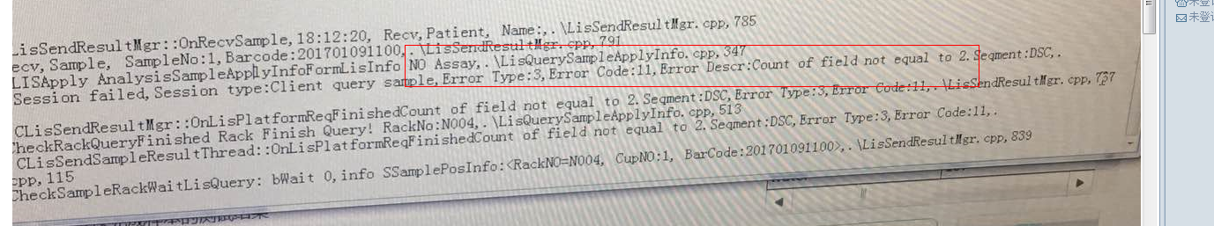
FAQ- Example
Error 3-11 Number of flieds is incorrect

Slide 18
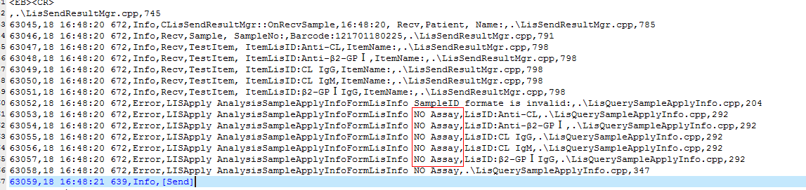
FAQ - Example
Does not set the test parameter or channel No.

Slide 19
Q & A
？

Slide 20
Thanks!

